Slide 1
We stopped
Teaching C
Meeting Embedded Berlin 2018

Slide 2
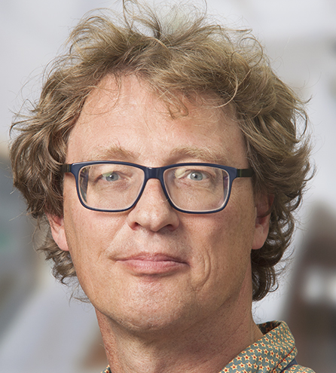

We
Wouter van Ooijen
wouter.vanooijen@hu.nl
Jorn Bunk
jorn.bunk@hu.nl

Slide 3
Topics
Context: institute, curriculum, trends
Why skip C
Experience
Conclusions, questions

Slide 4
Dutch higher education
Universities
Universities of applied science (HBO, ~ polytechnic)
HBO Utrecht
institute HBO-ICT
specialization Computer Engineering (Technische Informatica)
~ 6 lecturers

Slide 5
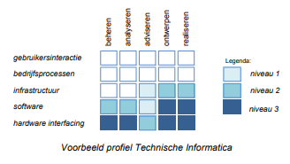
Our institute
HBO-ICT, specializations:
Applied Artificial Intelligence
Buisiness Information Management
Software & Information Engineering
Systems & Network Engineering
Technische Informatica (Computer Engineering)

Slide 6
Our institute
Applied Artificial Intelligence
Profiel
Basis
Richting
Artificial Intelligence
Business IT & Management
Data Science
Foundations of the ICT
Stage
Minor
(bijv. Big Data & Social Media, Creative Industry)
Afstuderen
Business Analist
Software Development
Interaction Designer
Front-end developer
System and Network Engineering
Back-end developer
Cyber Security
Technische Informatica
Cloud Engineer
Embedded Systems
(e.g. robotica, IoT)
Jaar 1
Jaar 2
Jaar 3
Jaar 4

Slide 7
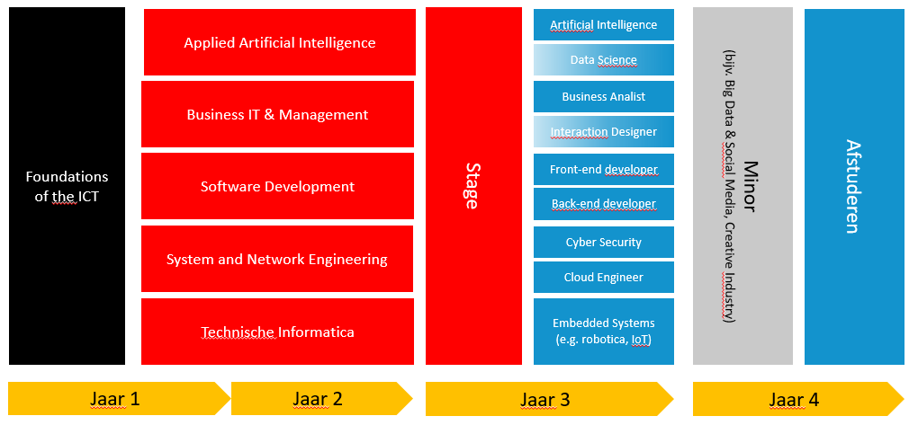
Our institute
4 y ( 4 * 60 = 240 EC)
0.5 y (30 EC) common introduction
1.5 y (90 EC) specialization (BIM, SNE, SIE, AAI, TI)
2.0 y (120 EC) internships, profile, minor

Slide 8
Computer Engineering
~ 60 students/y (2 or 3 classes of 20..30)
Focus on close-to-the-hardware and resource-constrained:
Embedded, micro-controllers, robotics, Linux
Mostly C++, but also Python, Assembler (,C)
+ We work with physical stuff
- Technical work seems to be frowned upon (in our country)

Slide 9
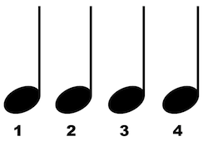
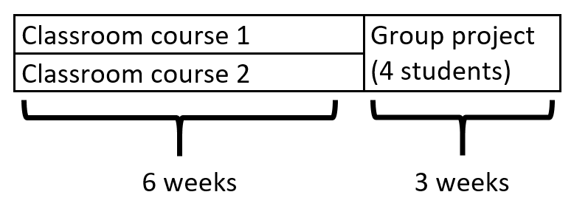
Quarter rhythm
9 weeks
6 weeks: 2 classroom courses
3 weeks: 1 group project

Slide 10
Common first half-year
Q1
Programming (Python)
Computer systems & networks
ICT and organization
Q2
Modelling (BPMN, use-cases, databases)
ASK (Critical thinking, logics, statistics)
Group project (collaboration, agile, professional skills)

Slide 11
Computer engineering – y1
Q3
procedural programming (algorithmics, C++)
operating systems (Linux, RaPi)
Lego Robotics (Lego + BrickPi, C++)
Q4
OO programming and micro-controllers (classic C++, ArduinoDue)
Digital and analog electronics, computer architecture
1st year final project (individual, ArduinoDue, C++)

Slide 12
Computer engineering – y2
Q5
Low-level programming (assembly, C++, threading)
Real-time modelling (UML & synchronization)
Laser-Tag project (ArduinoDue, RTOS, modelling, waterfall, C++)
Q6
High-level programming (C++, resources, STL, patterns, MSVS, SFML)
Datastructures & algorithms (lists, trees, hashmaps; Python)
Game project (SFML, PC/Linux/Mac, Agile/scrum, Fagan inspection, C++)

Slide 13
Computer engineering – y2
Q7
MRB (sensors, actuators, control)
Vision (image processing)
Development department (applied research)
All students together, changing sub-teams
Proposals, team construction, work, dependencies
Continuous integration, tests, changing requirements
Self-organizing, scrum
Q8
Research
Development department cont. – 15 EC total

Slide 14
Computer engineering – y3/4
Q9 or later
Advanced Programming
Functional programming, introspection
Python/C++ integration, test-strategy
Applied AI
neural networks, classifiers
Inter-disciplinary project (20 EC)

Slide 15
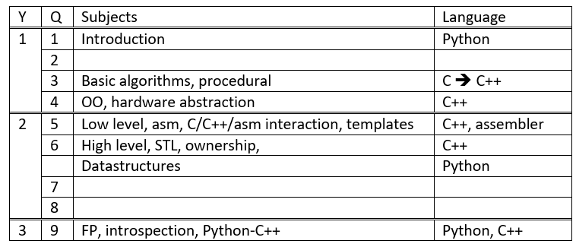
Programming

Slide 16

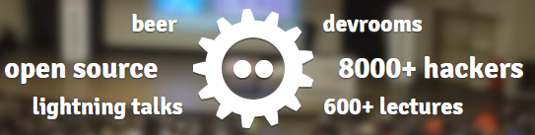

Some ’recent’ trends
More HBO-ICT integration
First language (shared) Java ➔ Python
One 2.5 EC C++ course (classic OO)
➔ 4 * 5 EC courses (each 50% C++): 4-fold increase
Smallest hardware
PIC16F630 (asm) ➔ 18F452 (C) ➔ ArduinoDue (C++)
Direct HW register interfacing ➔ abstraction of the hardware
Our own lab
The students visit conferences

Slide 17
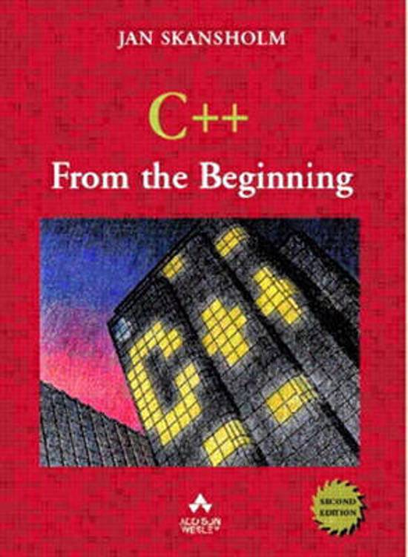


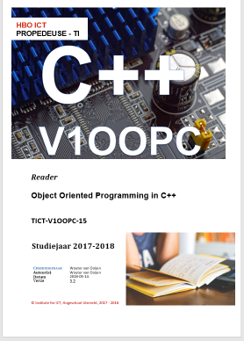
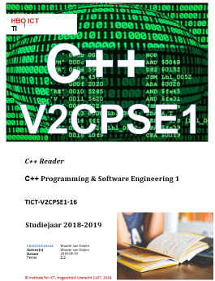
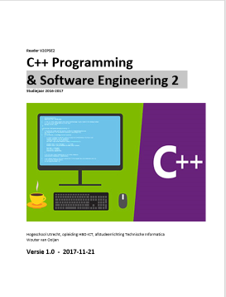
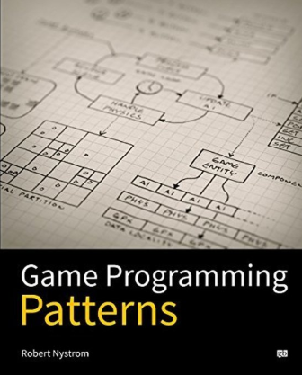
Course materials
2005:
Book by Skansholm (classic OO)
Book ‘In zee met C’ (almost K&R C)
2018:
Reader PPC
Reader OOPC
Reader CPSE1
Reader CPSE2 (+ book)

Slide 18
Course materials
Why not use existing material?
Material decides course content
Academic ⬄ practical
Often either for total beginner, or as 2nd language
Not up-to-date with the latest standard
English only (we prefer Dutch for y1)

Slide 19
Curriculum design
What decides what we teach in the curriculum?
What we want to teach!
Comply with HBO-ICT framework (Dutch standard)
What decides the partitioning (what we teach in a course)?
Partitioning in 5 EC courses
Synergy with SE subjects (agile/waterfall, design, testing, style, …)
Fun: weekly assignments
Synergy with other courses
Avoiding forward references
Even or ascending level of difficulty

Slide 20
What is ‘C++’ anyway?
Application field – specific styles (OO, templates, better C, …)
Version – dependent styles & idioms (98, 03, 11, 14, 17, 20, …)
The lastest and hottest – or also the past
The ‘user’ level – or also ‘under the hood’
Language – or also libraries? Boost?

Slide 21
C++ education challenges
What exactly to teach
Variations in entry level
Long chain of dependent courses
Avoiding forward refrences
Bottom-up versus top-down
Theory, deep knowledge, personal growth ⬄ immediate applicability

Slide 22
Difficult to…
(for us)
Agree on what to teach
Find (or create) teaching material
Justify updating the material
Find lecturers (preferrably young & experienced…)
(for the students)
Find good on-line examples & advice
Find internships

Slide 23
But on the positive side
No worries about employment
Active conference and on-line communities
Cheap embedded hardware (Pi, Arduino, …)

Slide 24
Why skip C?
Focus shift towards abstraction:
hardware register interfacing ➔ hardware abstraction
No subsequent C courses
No C-only targets
C++ has (slightly) less noise and clutter
Avoid C ➔ C++ transition pain
Cost: loose pure C programming

Slide 25


Why is programming so hard?
Notes:
It isn’t!
The problem for students is that we want to learn them a lot in a short amount of time and everytime they finally understand something. We don’t give and have the time to let the students enjoy their new aquired skills. We learn them to cycle. They work hard and learn it in a week. The following week we say: “great you learned to cycle, but know do it on a unicycle”.
We don

Slide 26
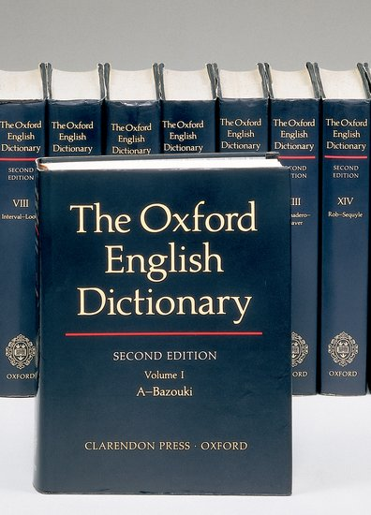


What to learn?
For the students there are two challenges:
Syntax
(Procedural) Problem solving
Notes:
There are two main parts that they need to learn: synax and problem solving. Often we see that courses try to learn people a new language, if it is a programming language or a natural language, want to explain the syntax completly and with all details.
With your head full of these details and no way of seeing what is important and what not, because you haven’t used it yet can make your head explode. Leaving no room in your head to think about the programming problem you are trying to solve.
And that would be the positive result. A student’s head that explodes in the lessons can be easily spotted. As a teacher you can help these students.
The real problem are silent students who get completly stuck because of an overload of information and are completly stuck.
Focusing on both

Slide 27

Designing the new course
Notes:
Focus on algoritmic thinking

Slide 28
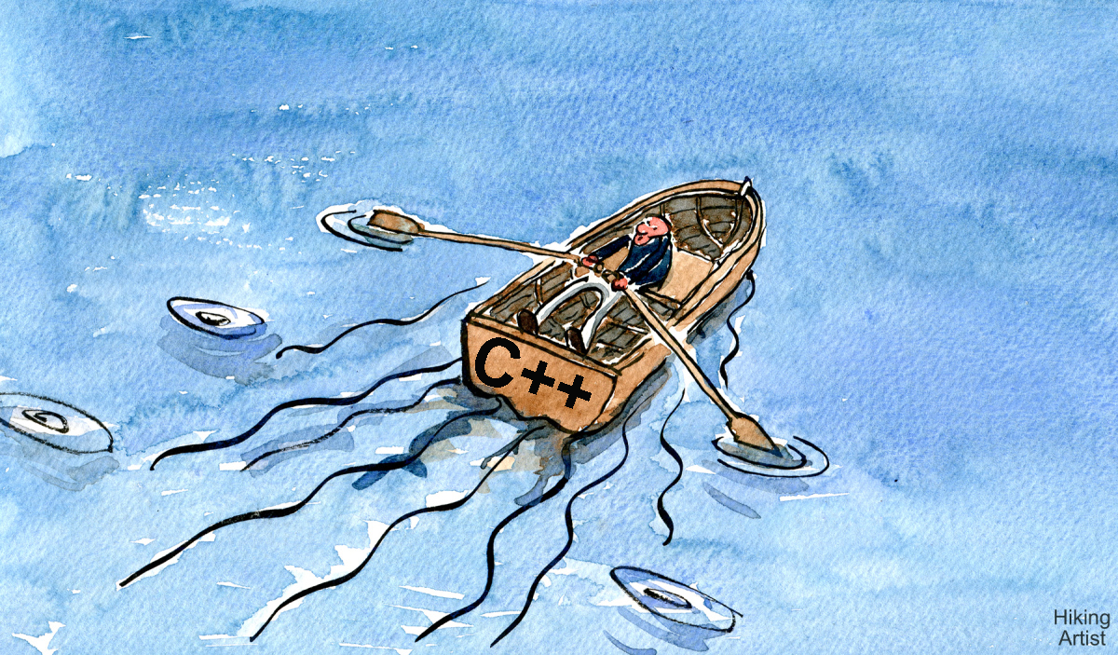
Designing the new course
Notes:
C++ as the boat
For this course merely a vessel. In later courses they will use C++ more it its full extend (for Object oriented). For now we only use the "Better C subset" + vectoren

Slide 29
Designing the course
We removed from the course:
Switch
Do-while
Static variabeles
Main function parameters (argc, argv)
MACRO’s
Arrays / c-string
Pointers
Printf() / scanf()
And a lot of (for now) irrelevant details.
Notes:
So we also kept a lot of things of the old course. But we find it is more interesting to talk about what we don’t learn the students in the course. Because people can be very passionated about some of these topics.
So we started with what can we remove, we came to the following list.
These were all subjects in the old course
So we don’t want to hit the students

Slide 30
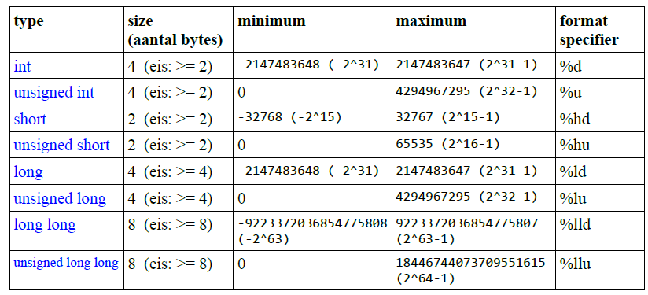
The old reader: integers
Notes:
The old reader contained a lot of detail

Slide 31
The new reader: integers (1/2)
#include <iostream>
using namespace std;
int main(){
int number = 6;
number = number + 1;
number = number * 2;
cout << "number: " << number << "\n";
// number: 14
int x = 8 - 4;
cout << "x: " << x << "\n";
// x: 4
}
Notes:
The new readers contain a lot of examples (with explaination). Every example is code that can be copied and pasted into an IDE and run immidetaily.
The old reader had example, code but it was not in the reader. There were only a few students who took a look at it.
This example gives student almost everything the need to work with integers. Of course they need to know what happens when we work with fractions

Slide 32
The new reader: integers (2/2)
#include <iostream>
using namespace std;
int main(){
int y = 4.9;
cout << "y: " << y << "\n";
// y: 4
int z = 21;
int result = z / 6;
cout << "result: " << result << "\n";
// result: 3
}
Notes:
Fractions (floats) and integers
So we added this example.
We tell them nothing about the number of byte of an integer or what happens wen they put a higher number in it. That is not a worry for now.

Slide 33
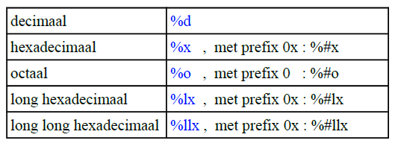
The old reader: output
int b = 14;
printf("The square of %d is %d", b, b*b);
printf("%#x %#o", 90, 420);
Notes:
The same we did with the output.
Printf feels a bit clunky for new students. You have to use placeholders that define how it is printed and at the end. Besides that our old course tried again to hit our students with the dictionary.
And reducing this complexity we repeated over all subjects. Such ad input/output
Hexadecimal and octal

Slide 34
The old reader: output
printf("\u03c0");
puts("");
printf("π");
puts("");
printf("%d\n", strlen("\u03c0"));
unsigned char s[] = "\u03c0";
printf("%#x %#x", s[0], s[1]);
Notes:
Is this import to teach in the first lesson if some of the students are still struggling with if-statements.

Slide 35
The new reader: output
#include <iostream>
using namespace std;
int main(){
char letter = 'd';
cout << "letter: " << letter << "\n";
// letter: d
char result2 = 'c' - 'a';
cout << "result2: " << int(result2) << "\n";
// result2: 2
}
Notes:
With C++ we can use cout which is easier to use. Furthermore now we don’t waste time learning the student printf() in the other programming courses they will also use C++ so they kan keep using cout
They know int(), char() from python course
See that we don’t remove all details. We make our students aware of that there is a relation between chars and bytes (also in excercises).
Using namespace because this reduce the writing complexity. std::cout

Slide 36
The old reader: input
int day, month, year;
int n;
printf("Datum in format: dd/mm/yyyy: ");
n = scanf("%d/%d/%d", &day, &month, &year);
printf("n: %d\n", n);
printf("The date is: %02d/%02d/%4d\n", day, month, year);
Notes:
First lesson, references
What does that & ampresant mean? Do we want to explain the difference between “by copy” and “by reference” to a student who just learned types and is still struggling with using functions and if-statements.
We still explain by reference, but we save it for week 4 in the 6 week course

Slide 37
The new reader: input
#include <iostream>
#include <string>
using namespace std;
int main(){
float price;
int quantity;
cout << "Enter price and quantity: ";
cin >> price >> quantity;
float total_price = price * quantity;
cout << "Total price: " << total_price << "\n";
}

Slide 38
The new reader: input
#include <iostream>
#include <string>
using namespace std;
int main(){
string sentence;
cout << "Enter a sentence: \n";
getline(cin, sentence);
cout << sentence;
}

Slide 39
Pointers
Critical concept
But difficult concept for novice programmers
// print k + 1 using n:
int k = 16;
int * n = &k;
cout << *n + 1 << "\n" // ?
cout << *(n + 1) << "\n" // ?
cout << &n + 1 << "\n" // ?
cout << &(n + 1) << "\n" // ?
cout << *(&n) + 1) << "\n" // ?
cout << &(*n) + 1) << "\n" // ?
Notes:
With a their heads full of trying to solve the algorithmic problem an easy mistake. Which make them uncertain about the programming skills in general.
They don’t know if they made an syntax mistake or an algoritmic mistake. That makes debugging hard for them.

Slide 40
C-array
//get all elements bigger than x from array:
int BiggerThan(int src[], int src_size, int dest[], int x){
int j = 0;
for(int i=0; i < src_size; i++){
if(src_size > x){
dest[j] = src_size[i];
j++;
}
}
return j;
}
Notes:
With c-style arrays we cannot easily return

Slide 41
Vector
//get all elements bigger than x from vector:
vector<int> BiggerThan(vector<int> v, x){
vector<int> result;
for(unsigned int i=0; i<v.size(); i++){
if(v[i] > x){
result.push_back(v[i]);
}
}
return result;
}
Notes:
When we work with vectors the different parts of the problem are much better seperated.
The parameters give our initial context
The anwser that of our problem is clearly markt with the return statement. And the type of our return value is also clearly sepearated from the parameters because it written before the function name.
Still there are some drawbacks:
We have to learn them unsigned int (otherwise warning when using v.size())

Slide 42
Other changes:
Learning by example, not by long explanations
Reader only contains correct code.
Exercises:
Other exercises types (e.g. reading exercises)
Each exercise has one learning goal.

Slide 43
Remaining challenges
Better (and more) exercises
Vector and recursion
Notes:
Excercises:
- Fill in the blank
Parsons problems
Tweaking code
Code review

Slide 44
Literal strings
void print(const string & words){
cout << words;
}
int main(){
string s = "Meeting Embedded";
print(s);
print("hello world"); // error: literal string!
}

Slide 45
Vector and recursion
int sum(vector<int> numbers){
if (number.size() == 0)
return 0;
int result = numbers[size-1];
numbers.pop_back();
result += sum(numbers);
return result;
}

Slide 46
Vector and Recursion
int sum(const vector<int> & numbers, int size){
if (size <= 0)
return 0;
return numbers[size-1] + sum(numbers, size-1);
}

Slide 47
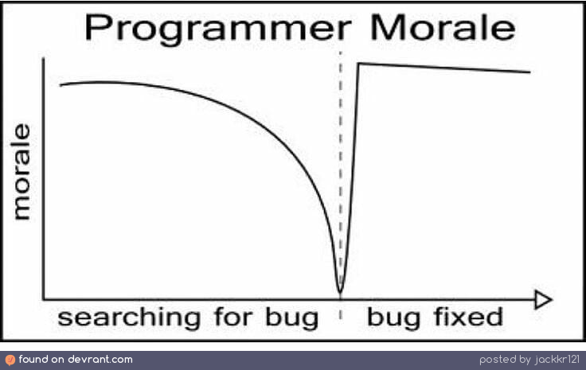
Results:
Students became better in
procedural program solving.
debugging the logic in code.
Students
are more confident.
have more fun.
No transition pain in first week next C++ course.
Notes:
More focus on functional decomposition and problem solving instead of language details
In C++ it is easier to do that
Student are better in debugging their code -> less mistakes in syntax

Slide 48
so
We stopped
Teaching C
So far the effect seems to be positive (1y, 60st)
Better start with the better-C subset than C-then-C++
We don’t cater for all (C is for electro?)

Slide 49
Questions?

Slide 50
We have a few…
What do you (industry) need?
C, C++, both, something else, everything
Specialists, generalists, profssional skills
Electronics, HW interfacing, SW
Specific experience (frameworks, libraries, tools, IDEs, targets)
Is there a future for hard-technical work in western europe?

